Slide 1

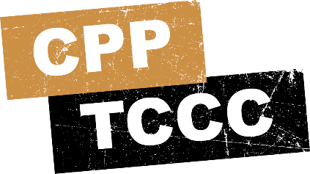


TACTICAL COMBAT CASUALTY CARE COURSE
MODULE 13: HEAD INJURIES
Module 13: Head Injuries
#TCCC-CPP-PPT-13 08 AUG 23
COMBAT PARAMEDIC/ PROVIDER
TCCC TIER 1
All Service Members
TCCC TIER 2
Combat Lifesaver
TCCC TIER 3
Combat Medic/Corpsman
TCCC TIER 4
Combat Paramedic/Provider

Slide 2




Module 13: Head Injuries
TACTICAL COMBAT CASUALTY CARE (TCCC) ROLE-BASED TRAINING SPECTRUM
ROLE 1 CARE
NONMEDICAL PERSONNEL
MEDICAL PERSONNEL
YOU ARE HERE
STANDARDIZED JOINT CURRICULUM
Notes:
In Module 13, we will discuss the assessment and treatment of casualties with suspected head injuries.
As a Combat Paramedic/Provider (CPP), it is important that you understand the roles and responsibilities of the nonmedical personnel (All Service Members (ASM) and Combat Lifesaver (CLS), and Combat Medics/Corpsmen (CMC)) who may be assessing and providing care/assisting in the treatment of casualties with suspected head injuries in the prehospital environment.

Slide 3



Module 13: Head Injuries
1 x TERMINAL LEARNING OBJECTIVE
15 Identify a head injury IAW DoDI 6490.11, Change 1, 1 June 2018.
Identify the signs, symptoms, and external forces that cause head injuries in Tactical Field Care.
Identify the indications for performing a Military Acute Concussive Evaluation 2 (MACE 2) for a casualty with a suspected head injury.
15.3 Identify the progressive strategies and constraints for management of a suspected head injury in Tactical Field Care.
Identify the signs and symptoms of impending cerebral herniation in Tactical Field Care.
Identify the TCCC indications, contraindications, and administration methods of 3%, 5%, or 23% hypertonic saline to a traumatic brain injury casualty in Tactical Field Care.
Identify any evidence-based medicine, best practices, casualty data, and Subject Matter Expert consensus on the management of traumatic brain injury in Tactical Field Care.
15.1
15.2
15.4
15.5
15.6
06 x ENABLING LEARNING OBJECTIVES
= Cognitive ELOs
Notes:
There are six cognitive learning objectives for this module.
The cognitive learning objectives are to identify external forces that can cause a head injury; identify signs and symptoms of a head injury; identify the indications for performing a Military Acute Concussive Evaluation 2 (MACE 2) for a casualty with a suspected head injury; identify the progressive strategies and constraints for management of a suspected head injury; identify the signs and symptoms of impending cerebral herniation; identify the indications, contraindications, and administration methods of hypertonic saline in suspected traumatic brain injury (TBI); and describe the evidence supporting the strategies and recommendations for assessing and treating head injuries and suspected TBI.

Slide 4
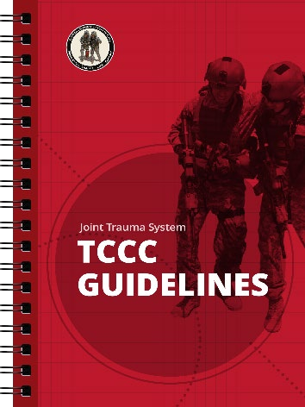
Three PHASES of TCCC
Module 13: Head Injuries
1
CARE UNDER FIRE (CUF)
/ THREAT
2
TACTICAL FIELD CARE (TFC)
WORK UNDER COVER AND CONCEALMENT
3
TACTICAL EVACUATION CARE (TACEVAC)
RETURN FIRE AND TAKE COVER
MORE DELIBERATE ASSESSMENT AND PRE- EVACUATION PROCEDURES
Additional Traumatic Brain Injury guidance outlined in TEC phase of the TCCC Guidelines
05 NOV 2020
Notes:
Tactical Field Care usually affords relative safety and time to expand the focus of assessment and management beyond immediate life-threatening hemorrhage control to allow treatment of other injuries and prevention of potentially life-threatening complications including the prevention and treatment of head injuries.
Keep in mind that the tactical situation is fluid and that the duration of the TFC phase of care could vary from minutes to hours depending on the tactical situation and the availability of evacuation assets.
When discussing head injuries, it is also important to understand that during the Tactical Evacuation Care phase additional emphasis is placed on the assessment and treatment of TBI and preparation for evacuation during Tactical Field Care, when possible, should encompass some of those principles.

Slide 5
MARCH PAWS
Module 13: Head Injuries
LIFE-THREATENING
AFTER LIFE-THREATENING
PAIN ANTIBIOTICS
WOUNDS SPLINTING
M A R C
MASSIVE BLEEDING
#1 Priority
P A W S
AIRWAY
RESPIRATION (Breathing)
CIRCULATION
H
HYPOTHERMIA / HEAD INJURIES
Notes:
Assessment and treatment of head injuries is one part of the “H” in the MARCH PAWS sequence (which also includes hypothermia prevention and management).

Slide 6

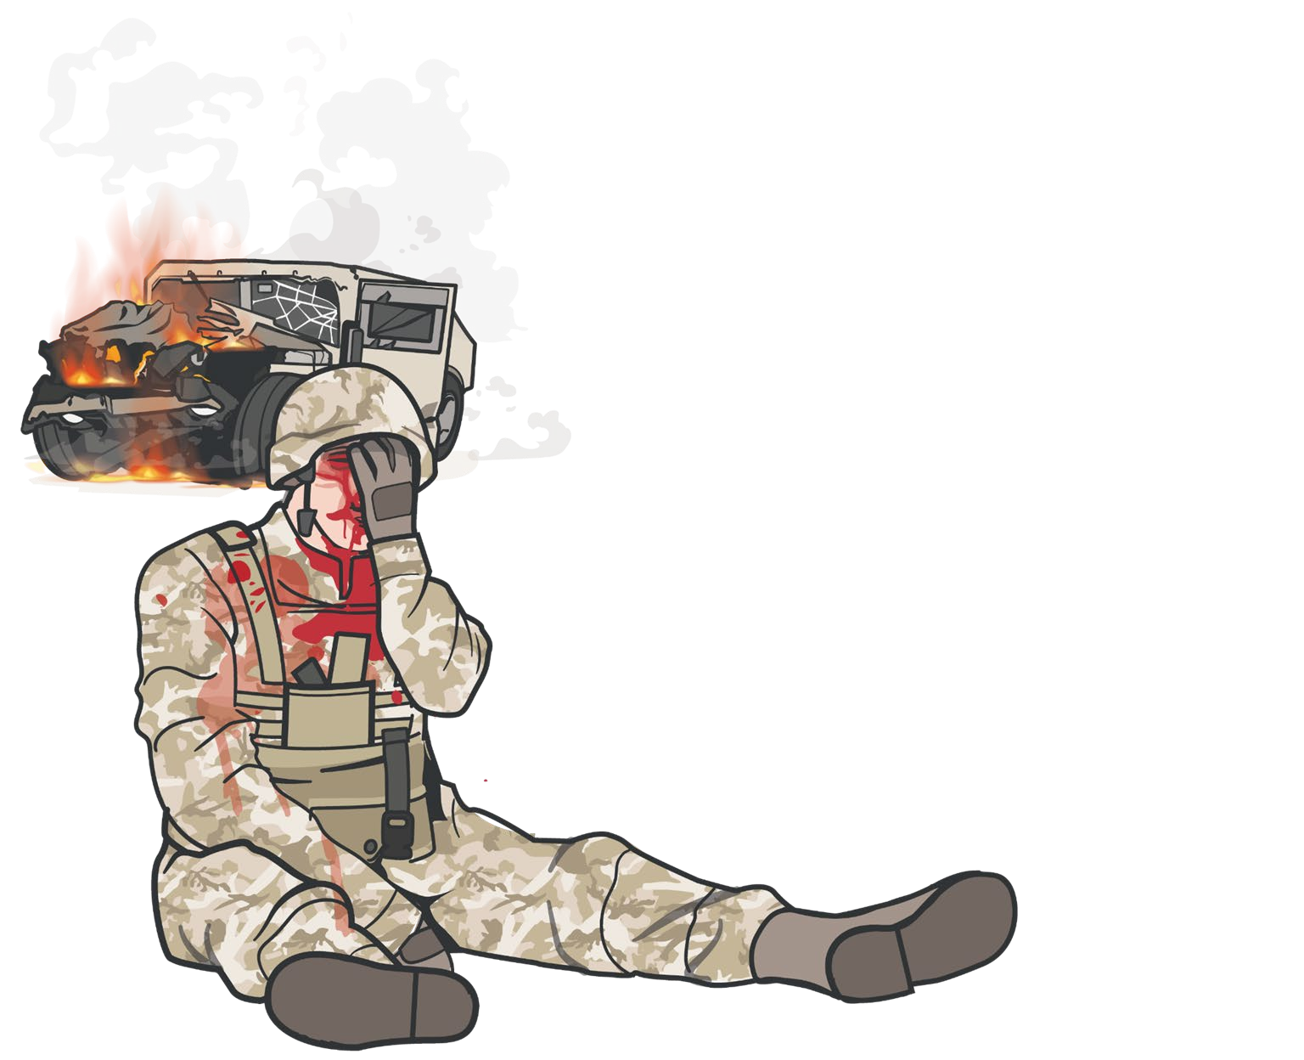


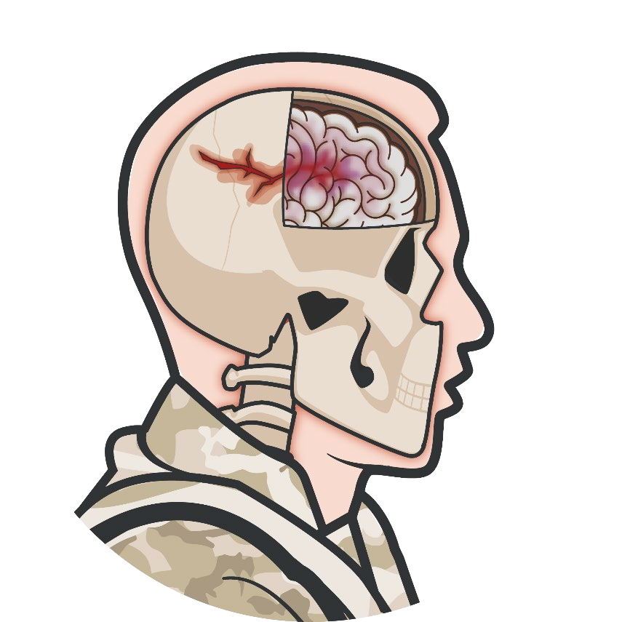
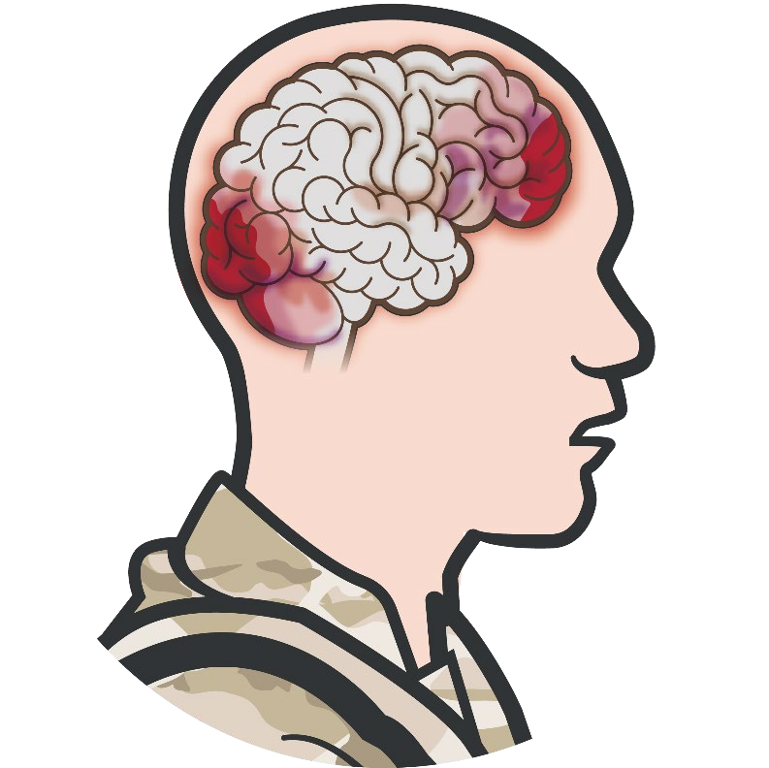

HEAD INJURIES / TRAUMATIC BRAIN INJURY
Module 13: Head Injuries
HEAD INJURY IS TRAUMA TO THE SCALP, SKULL, FACE, OR BRAIN
Penetrating TBI/open head injury -
Skin is broken and often the skull has been penetrated
Blunt TBI/closed head injury -
Skin is not broken and no damage to the skull is noted
Primary injuries -
Direct impact, rapid acceleration-deceleration, or penetration
Secondary Injuries -
Systemic hypotension, hypoxia or an increase in intracerebral pressure after initial insult
Open head injuries may be obvious while
Closed head injuries may subtle
Notes:
Head injury includes trauma affecting the scalp, face, skull, and/or the brain. Although not all head injuries result in traumatic brain injury (for example, a scalp laceration or facial injury without underlying skull and/or brain involvement), the majority involve some degree of brain injury, even if it is subclinical. For that reason, the terms head injury and traumatic brain injury (or TBI) are used almost interchangeably in medical literature and in military medical doctrine.
In open head injuries, the skin is broken and often the skull has been penetrated, resulting in direct traumatic brain injury; these head injuries are typically fairly obvious.
Closed head injuries, where the skin is not broken and no damage to the skull is noted, can also result in TBI; but this type of head injury may not be obvious and findings may be very subtle.
Primary injuries include direct injury from an initial impact that causes displacement of the brain due to direct impact, rapid acceleration-deceleration, or penetration.¹ In penetrating injuries this is a combination of a wound that may require treatment (hemorrhage control, for example) and attention to the effects of TBI. Regardless of whether they are open or closed, these injuries may cause brain contusions, hematomas, or axonal injuries.²
Secondary injuries can be seen with changes that occur after the initial insult. They can be due to systemic hypotension, hypoxia or an increase in intracerebral pressure.³

Slide 7

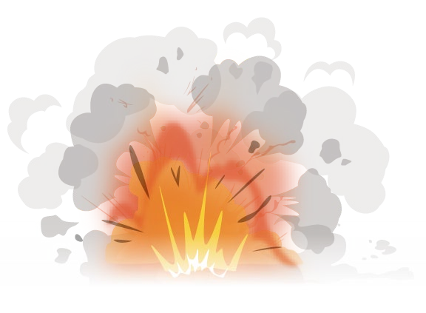
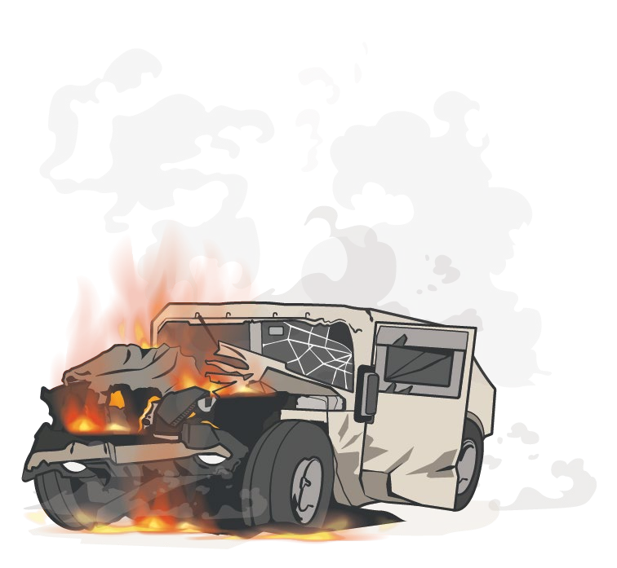


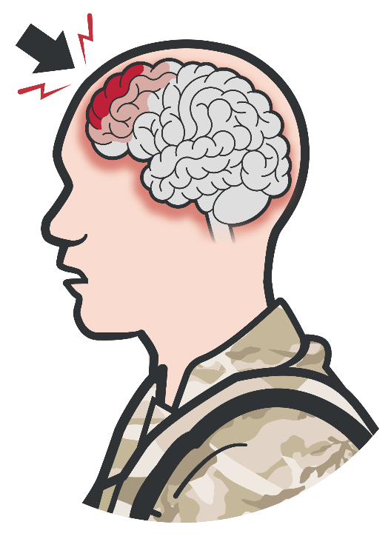
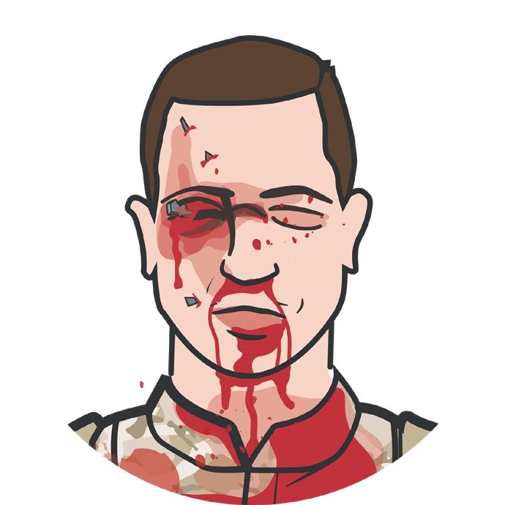
EXTERNAL FORCES IN HEAD INJURIES
Module 13: Head Injuries
PENETRATING
Gunshot or shrapnel wound Falls, accidents, assault
Blasts
MVAs
CLOSED
Blunt
Blast
MVA/rollover
Direct blow to the head without penetrating wound
Witnessed loss of consciousness
Presence within 50 meters of a blast (inside or outside)
Exposure to more than one blast event
Direct Blow to the Head
Gunshot/ Shrapnel
Notes:
The mechanism of injury is often your first clue that a casualty may have sustained a head injury.
Forces that cause open or penetrating injuries are often due to a gunshot or shrapnel wound in combat situations, but direct impact to the head from almost any object can lead to a penetrating wound and skull fracture. This can be seen in motor vehicle accidents, injuries when the head hits an object (falls, accidents), or when an object hits the head (assaults, accidents, and the previously mentioned gunshot or shrapnel wounds).⁴
Forces that cause closed head injuries include blunt injuries from direct contact with an object that does not penetrate or cause an open wound, rapid acceleration-deceleration events, and blast injuries. Typically, blast forces can cause head injuries to anyone within 50 meters, but depending on the strength of the blast, that radius can be much greater.
DOD Instruction 6940.11 (DoD Policy Guidance for Management of Mild Traumatic Brain Injury/Concussion in the Deployed Setting) outlines these potentially concussive events, but notes that TBI is not limited to these events:⁵
Involvement in a vehicle blast event, collision, or rollover
Presence within 50 meters of a blast (inside or outside)
A direct blow to the head or witnessed loss of consciousness
Exposure to more than one blast event
Gunshot or shrapnel wound to the head, open skull fracture, etc.

Slide 8



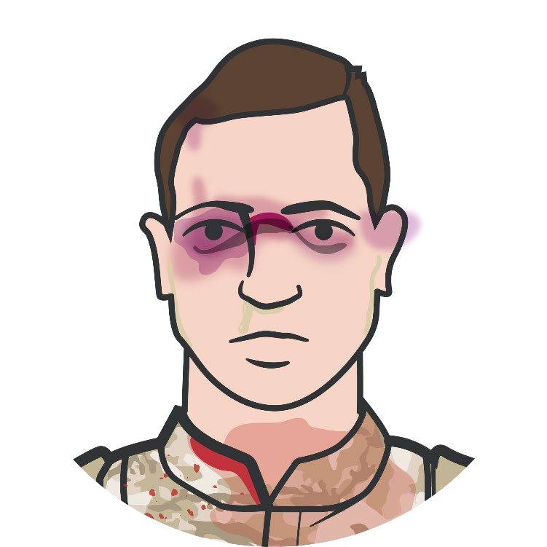
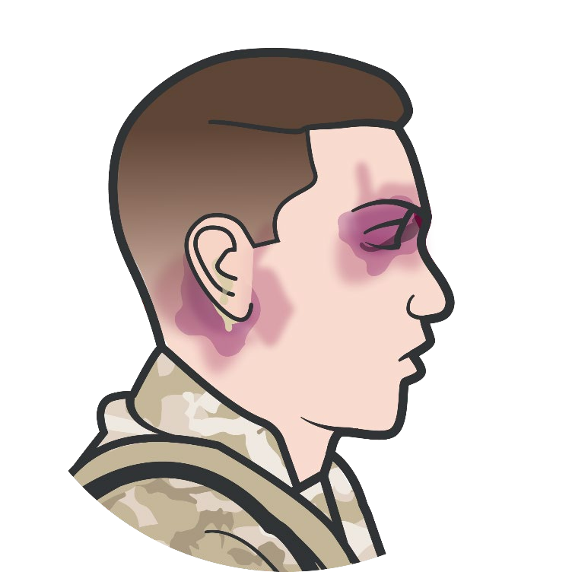
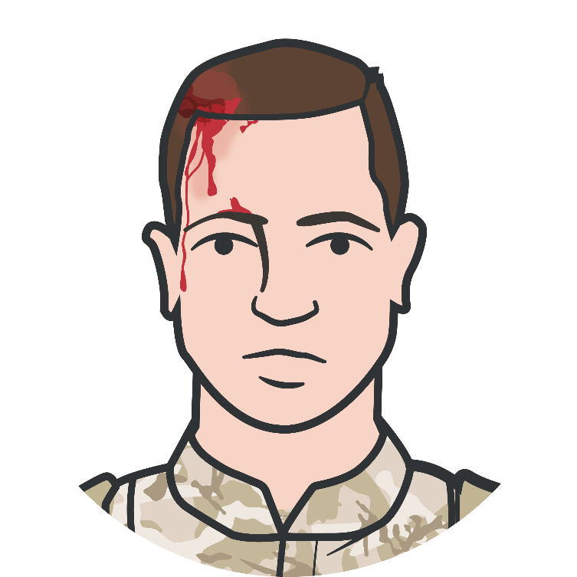

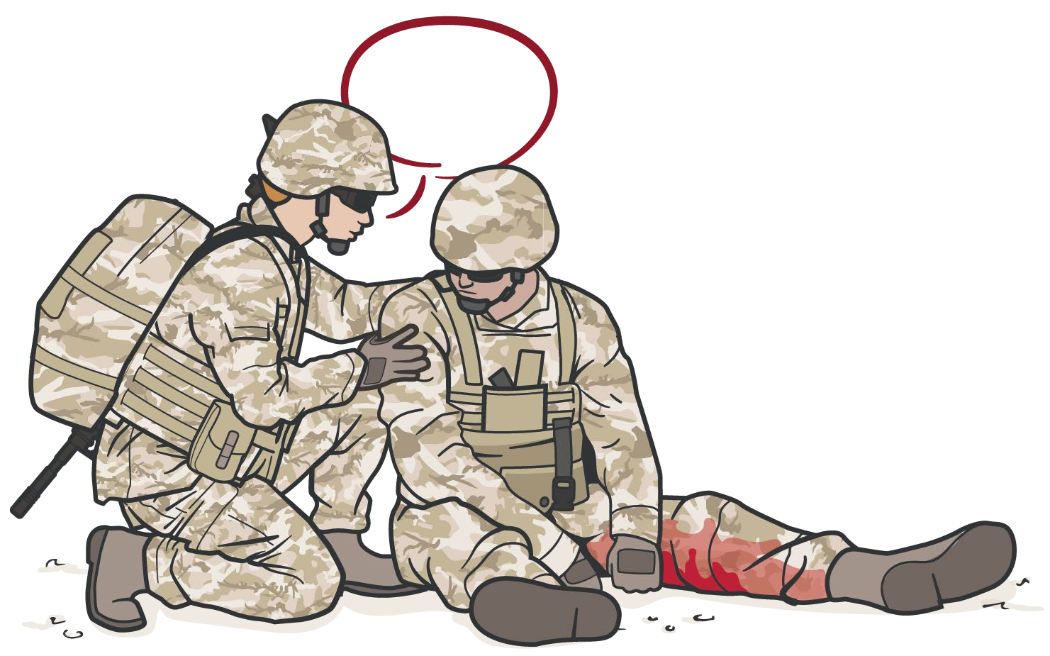

SIGNS AND SYMPTOMS OF HEAD INJURY
Module 13: Head Injuries
A lert
V erbal Stimuli
P ainful Stimuli
U nresponsive
COMMUNICATE WITH THE CASUALTY TO ASSESS FOR ALTERED MENTAL STATUS
Obvious scalp, skull wound, or deformity Raccoon’s Eyes or Battle’s Sign Otorrhea or rhinorrhea
(leakage of cerebrospinal fluid)
Pupillary dilation/focal neuro signs Altered mental status
Notes:
Signs and symptoms of head injuries and TBI are highly variable and depend on the specific areas of the brain affected and the injury severity.⁶
Visible wounds of the scalp or obvious deformity or penetrations of the skull noted during the trauma assessment can indicate a conventional or penetrating TBI, which are more obvious and easier to diagnose.⁷
Raccoon’s Eyes or Battle’s Sign, which are bruising around the eyes and behind the ears respectively, are signs of a basilar skull fracture.
The leakage of cerebrospinal fluid from the nose (rhinorrhea) or the ears (otorrhea) is also a sign that might indicate a skull fracture.
Pupil size differences and focal neurologic deficits can be seen.
Exposure to blasts or significant impacts from a fall or vehicle crash can lead to head injuries that are not always accompanied by obvious external signs. Altered mental status may be your first indication of a possible head injury.⁸ As mentioned in the discussion on the Tactical Trauma Assessment, the AVPU (alert, verbal, pain, unresponsive) assessment can help establish if there is a change in mental status, but even when alert you may notice that the casualty isn’t responding appropriately to the situation. However, keep in mind that in the combat or trauma setting, altered mental status may be secondary to hypovolemia and/or hypoxia in the presence of other injuries resulting in massive hemorrhage or altered respiratory status.

Slide 9

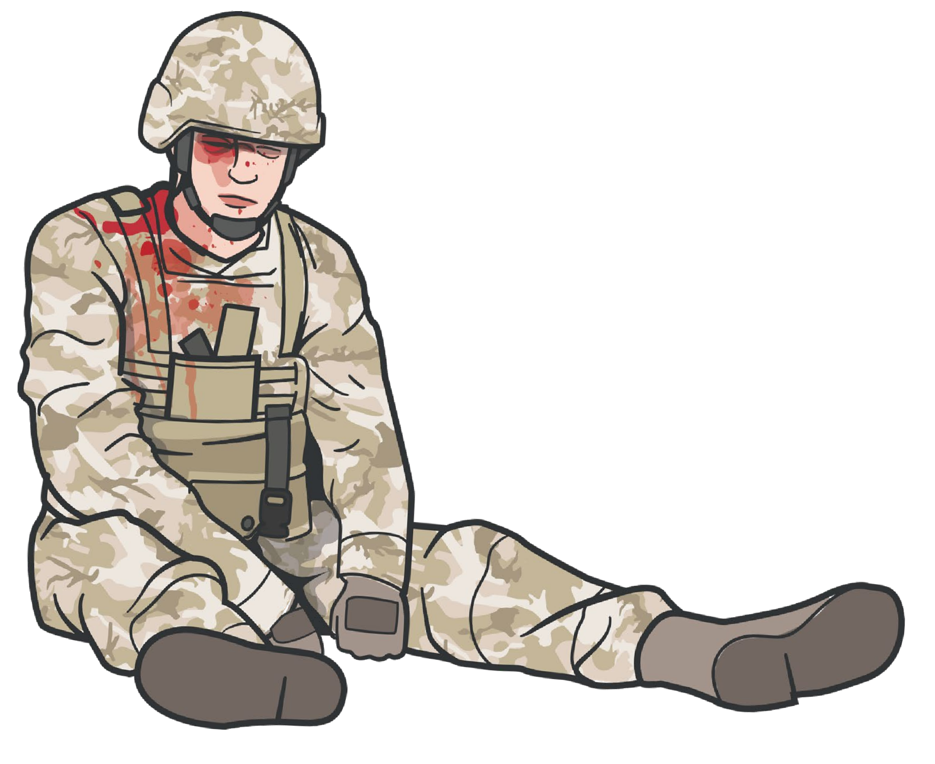

Module 13: Head Injuries
INDICATIONS FOR REFERRAL FOR MEDICAL EVALUATION
I
njury
Physical damage to the body or body part of a Service member?
YES
NO
E valuation
H: Headaches and/or vomiting?
E: Ear ringing?
A: Amnesia, altered consciousness, and/or loss of consciousness?
D: Double vision and/or dizziness?
S: Something feels wrong or is not right?
YES
YES YES YES YES
NO
NO NO NO NO
D istance
Was the Service member within 50 meters of the blast? Record the distance from the blast.
YES NO
Not applicable
DoDI 6490.11 (section 3, para 2.a)
Traumatic Brain Injury Center of Excellence
Notes:
The IED checklist described in DODI 6490.11 is an important tool for gathering information and identifying signs and symptoms of a head injury that warrant referral for a medical evaluation. The commander or their representative is ultimately responsible for ensuring the IED checklist is performed on anyone who may have a potentially concussive event.⁹ If there is a “yes” response to any of the IED checklist items, or if any other signs or symptoms suggestive of TBI are present, a medical evaluation is indicated.
I = Injury: refers to physical damage to the body or body part of a Service member.
E = Evaluation: includes the acronym HEADS, which asks if the casualty has any of the following:
H – Headaches and/or vomiting?
E – Ear ringing?
A – Amnesia, altered consciousness, and/or loss of consciousness?
D – Double vision and/or dizziness?
S – Something feels wrong or is not right?
D = Distance: asks whether the Service member was within 50 meters of the blast. It is also important to record the approximate distance from the blast.
Guidance for the medical evaluation is outlined in the Traumatic Brain Injury Center of Excellence provider resources.¹⁰

Slide 10



TRAUMATIC BRAIN INJURY CLASSIFICATION
Module 13: Head Injuries
Mild TBI (or concussion)
Casualty may remain conscious or lose consciousness only briefly (a few seconds or minutes up to 30 minutes)
Headache, ringing in ears, blurred vision, nausea/vomiting Dizziness/lightheadedness, impaired balance/coordination
Confusion/disorientation and/or memory loss (<24 hours)
Moderate TBI (symptoms similar to mild TBI) Confusion or disorientation (>24 hours)
Loss of consciousness (> 30 minutes but < 24 hours) Memory loss (>24 hours but < 7 days)
Severe TBI (symptoms similar to mild TBI)
Confusion or disorientation (>24 hours)
Loss of consciousness (> 24 hours)
Memory loss (>7 days)
Penetrating TBI –
in which the scalp, skull and dura mater are penetrated
*Unclassified TBI –
Limited surveillance information
#TCCC-CPP-PPT-13 08 AUG 23
10
Notes:
There are several different TBI classification systems found in medical literature. The Department of Defense Standard Surveillance Case Definition for TBI lists the following classifications for severity:¹¹
Mild TBI (or concussion)
Confused or disoriented state which lasts less than 24 hours
Loss of consciousness for up to 30 minutes
Memory loss lasting less than 24 hours
Excludes penetrating TBI
A CT scan is not indicated for most patients with a Mild TBI
Moderate TBI
Confused or disoriented state which lasts more than 24 hours
Loss of consciousness for more than 30 minutes, but less than 24 hours
Memory loss lasting greater than 24 hours but less than seven days
Meets criteria for Mild TBI except an abnormal CT scan is present
Excludes penetrating TBI
A structural brain imaging study may be normal or abnormal
Severe TBI
Confused or disoriented state which lasts more than 24 hours
Loss of consciousness for more than 24 hours
Memory loss for more than seven days
Excludes penetrating TBI
A structural brain imaging study may be normal but usually is abnormal
Penetrating TBI
A head injury in which the scalp, skull, and dura mater are penetrated
Penetrating injuries can be caused by high-velocity projectiles or objects of lower velocity such as knives, or bone fragments from a skull fracture that are driven into the brain
Unclassified TBI*
Previously, some cases were categorized as “unclassifiable” severity due to more limited surveillance information
Also in 2015, the Assistant Secretary of Defense clarified the TBI case definition
A subsequent review found that some of the remaining “unclassifiable” cases were likely moderate TBI. This change also will contribute to higher counts of *moderate TBI surveillance cases.

Slide 11

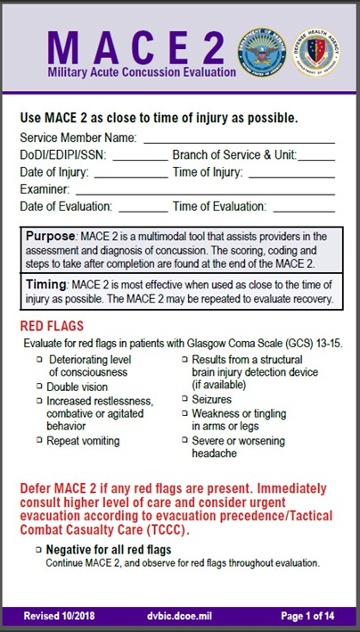

Module 13: Head Injuries
MILITARY ACUTE CONCUSSIVE EVALUATION 2 (MACE 2)
Trauma casualties with suspected head injury/TBI should be referred to the CMC and/or CPP as soon as possible for Military Acute Concussive Evaluation 2 (MACE 2)
If ANY of the following RED FLAG signs and symptoms are present, MACE 2 should be deferred and urgent evacuation considered:
Deteriorating level of consciousness Double vision
Increased restlessness; combative or agitated behavior Repeat vomiting
Results from a structural brain injury detection device (if available) Seizures
Weakness or tingling in arms or legs
Severe or worsening headache
Level of Evidence: C-EO
11
Notes:
As just mentioned, trauma casualties with suspected head injury/TBI due to a positive IED checklist, a suggestive mechanism of injury, obvious head wounds, or proximity to blast event (within 50 meters) should be referred to medical personnel as soon as possible for Military Acute Concussive Evaluation (MACE 2). The MACE 2 incorporates current state-of-the-science traumatic brain injury information, including vestibular-ocular-motor screening.¹² An instructor guide is available on the Traumatic Brain Injury Center of Excellence website to help guide the administration of the evaluation.¹³
This evaluation is most effective when done as soon as possible after the injury.
If ANY of the following RED FLAG signs and symptoms are present, MACE 2 should be deferred and urgent evacuation to a higher level of medical care considered:
Deteriorating level of consciousness
Double vision
Increased restlessness; combative or agitated behavior
Repeat vomiting
Results from a structural brain injury detection device (if available)
Seizures
Weakness or tingling in the arms or legs
Severe or worsening headache

Slide 12
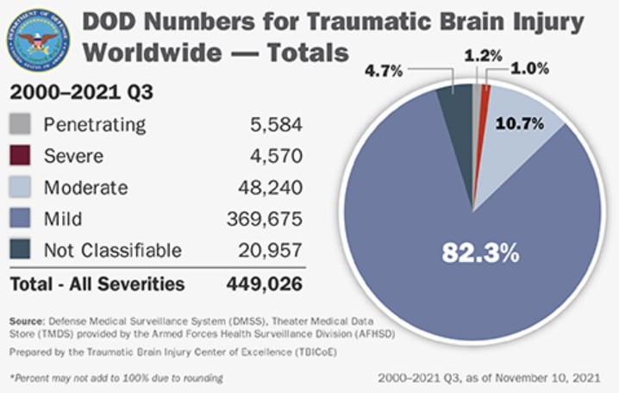

MANAGEMENT OF SUSPECTED HEAD INJURIES
Module 13: Head Injuries
Head Injury Management Guidance
TCCC Guidelines
JTS CPG on Traumatic Brain Injury Management in Prolonged Field Care
Defense Health Board – Management of Traumatic Brain Injury in TCCC
Brain Trauma Foundation
CAUTION: Be Alert and Prevent Secondary Brain Injury caused by hypoxia and hypotension
DOD TBI Worldwide Numbers – Traumatic Brain Injury Center of Excellence
Level of Evidence: C-LD
Notes:
The vast majority of TBIs are categorized as mild and are not considered life-threatening. Of the 449,026 cases of TBI in the DoD between 2000 and the 3rd quarter of 2021, 82.3% were mild using the definition we just discussed.¹⁴ However, it is important to recognize this injury because if a patient is exposed to a second head injury while still recovering from a mild TBI, they are at risk for increased, long-term cognitive effects. Moderate and severe TBIs are life-threatening injuries.¹⁵
The Brain Trauma Foundation Guidelines list 11 treatment recommendations for inpatient treatment of severe TBI that, although not all applicable to the prehospital setting, provide insight into the evidence supporting the mitigation of secondary injuries that can be applied to the Tactical Field Care setting.¹⁶ And the Joint Trauma System Clinical Practice Guideline, Traumatic Brain Injury Management in Prolonged Field Care (CPG ID: 63), provides several recommendations which can be used in TFC. These draw from findings of the Defense Health Board review of management of TBI in TCCC done in 2012¹⁷ and take into account the TCCC Guidelines that also refer to recommendations regarding TBI management.¹⁸
There are no effective treatments for primary injuries other than hemorrhage control and wound care followed by prompt evacuation. Secondary injury, in contrast, occurs as a result of a complex physiologic response that can cause short-term (immediate) effects and long-term sequelae. Thus, the primary focus of TBI management is on limiting the effects of secondary brain injury.¹⁹ This involves the management of hypotension, hypoxia, hypocarbia or hypercarbia, hypoglycemia, and elevated intracranial pressure (ICP).²⁰
The level of evidence supporting the guidance for the basic management of suspected head injuries is based on retrospective reviews and some prospective studies.

Slide 13

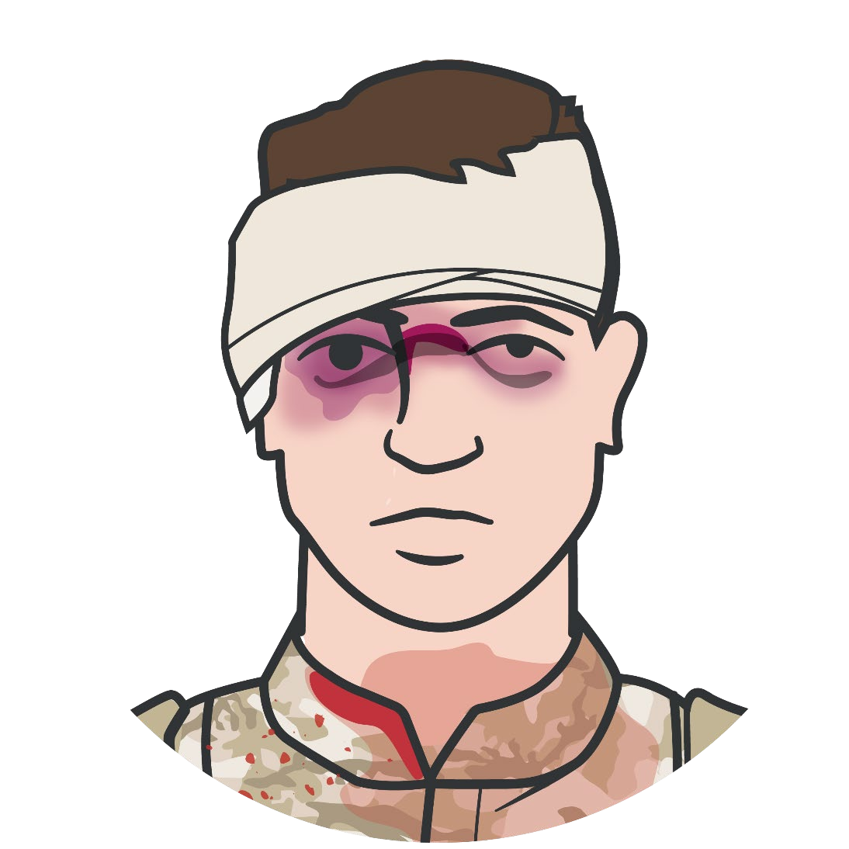
Module 13: Head Injuries
MANAGEMENT OF HEAD INJURIES
Avoid hypotension and decreased cerebral perfusion
Control hemorrhage from head and other injuries Administer TXA as indicated
Resuscitate with blood products to a maintain SBP 100-110 mmHg
Avoid medications that lower blood pressure
Control airway, ventilate, oxygenate
Secure airway (low threshold for advanced airways)
Ventilate to avoid hypo- or hypercapnia; ETCO2 target range 32-38mmHg
Prevent hypoxemia, maintain SPO2 >90%; provide supplemental O2, when available
Consider URGENT EVACUATION to a higher level of care
Ensure low oxygen saturations are not due to tension pneumothorax and intervene if needed
Notes:
Treatment for the patient with a suspected head injury/TBI should be initiated as soon as possible following acute injury. As severe head injury is associated with additional trauma in 60% of patients,²¹ it is important to complete your MARCH assessment and treatment process and address all other injuries, as they may create secondary brain injuries if they are not adequately addressed.
Hemodynamic control can help avoid hypotension and decreased cerebral perfusion. Hypotension in the presence of TBI is associated with a significant increase in mortality.²² Both the magnitude and the duration of the prehospital hypotensive episode have been found to contribute to increased mortality.²³ This is addressed in the massive hemorrhage and circulation steps of the MARCH algorithm. Specific issues and recommendations include:
Control hemorrhage from head and other injuries to avoid blood loss and subsequent hypotension.
Administer TXA as indicated per TCCC Guidelines.^{24,25,26}
If there is evidence of bleeding, transfuse whole blood or, if not available, transfuse blood products or resuscitate to a target SBP >110mmHg (monitor and maintain normal radial pulse if blood pressure monitoring is not available).^{27,28,29,30}
Avoid medications that may lower the blood pressure (e.g., narcotics). Unlike the opioid agents, ketamine causes a mild increase in heart rate and perhaps a slight rise in blood pressure, which makes its use in trauma settings advantageous for casualties in hemorrhagic shock.³¹ Although TBI does NOT preclude the use of ketamine or fentanyl, caution should be used when administering in casualties suspected of TBI as it may make it difficult to assess mental status, perform a neurologic exam, or determine if the casualty is decompensating.
Appropriate airway control, ventilation, and when possible, supplemental oxygen will also help prevent secondary injury by maintaining optimal cerebral oxygenation. Some considerations include:
Maintain a secure airway.³² This includes having a low threshold for establishing an advanced airway, which will also make ventilation and oxygenation easier, in most cases.
Avoid hypocapnia or hypercapnia by managing ventilations. If possible, monitor end-tidal carbon dioxide (EtCO₂) and adjust ventilations to achieve the target range of 32-38mmHg. Avoid hyperventilation (EtCO2 <32mmHg) except in extreme cases where imminent herniation is suspected because hyperventilation worsens cerebral ischemia. But also avoid hypoventilation (EtCO₂ >38mmHg) that will increase intracranial pressure (ICP).³³
Prevent hypoxemia. Provide supplemental oxygen if available. Monitor with pulse oximetry and maintain oxygen saturation >90%.³⁴ Ideally, the SpO₂ would be >95%.
Elevated intracranial pressures impede cerebral blood flow and should be monitored for and managed aggressively. A couple of considerations include:
Head elevation. Elevation of the head of the casualty/litter to 30-45 degrees.³⁵ ICP is reduced by displacement of cerebrospinal fluid from the intracranial compartment as well as promotion of venous outflow. Although the mean carotid pressure is reduced during head of bed elevation, ICP is reduced and cerebral blood flow (CBF) is unaffected.³⁶
Administer hypertonic saline. We’ll go over this in detail as part of a discussion on cerebral herniation in a minute, but hypertonic saline can be administered without clear evidence of herniation if there is suspicion of increase ICP.
Other management considerations include:
Prevention and treatment of hypothermia. Retrospective studies have demonstrated that hypothermia has a significant negative impact on mortality in patients with TBI.^{37,38}
Administration of antibiotics. Antibiotics should be used for open or penetrating TBI, as retrospective reviews and expert opinion strongly support their use.^{39,40}
Casualties with an altered mental status due to head injury often act (and react) inappropriately and can be a potential danger to themselves, first responders, and their unit and mission. As a result, it may be necessary to secure their weapon(s) and communication equipment, as discussed previously.
Throughout the management of suspected TBI, consideration for urgent evacuation to a higher level of care should take place.

Slide 14

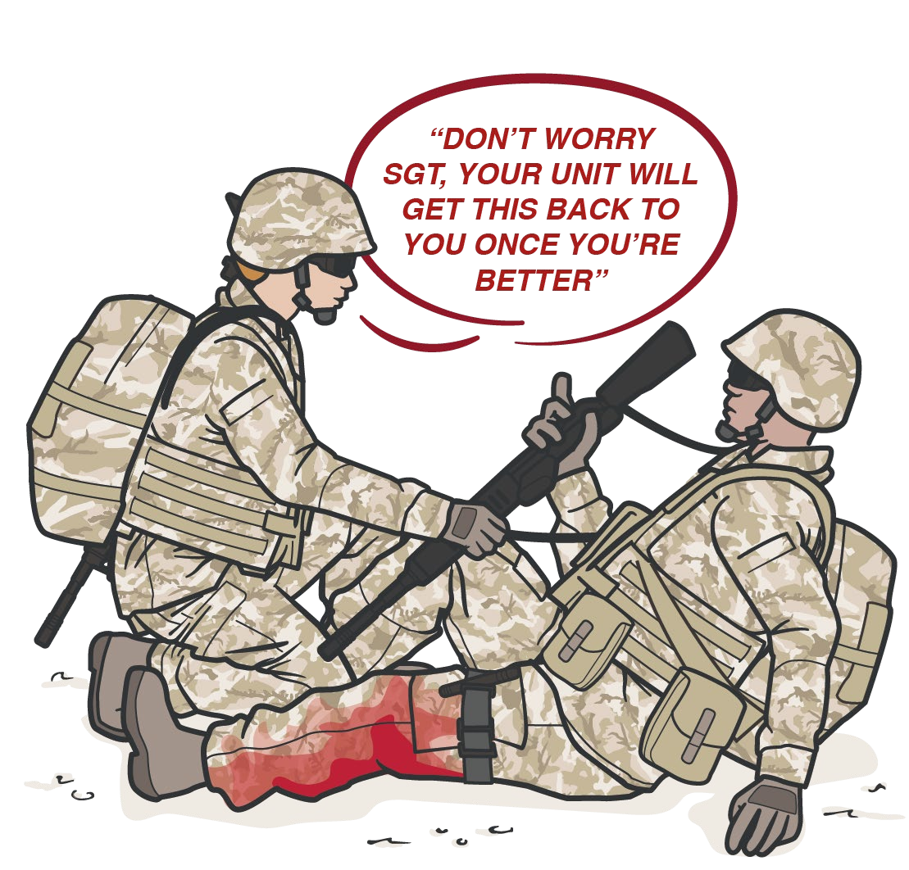
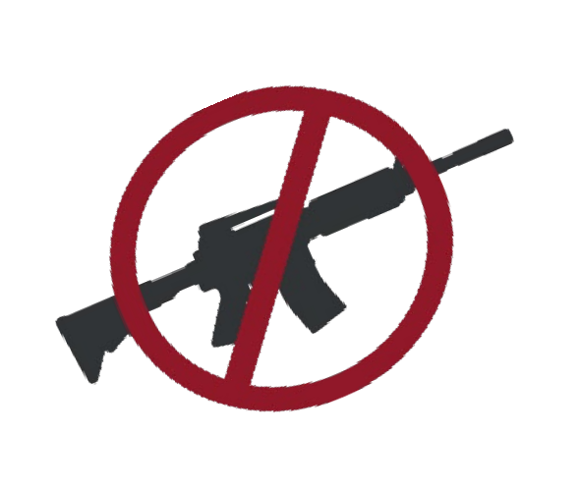

Module 13: Head Injuries
MANAGEMENT OF HEAD INJURIES
Avoid elevated intracranial pressure (ICP)
Elevated head/litter stretcher Administer hypertonic saline
Other considerations
Prevent/treat hypothermia Administer antibiotics, if appropriate Manage pain per TCCC guidelines
Treat other immediately life-threatening injuries to prevent hypoxia and hypotension
Remember to remove weapons and comm equipment from casualties with altered mental status

Slide 15


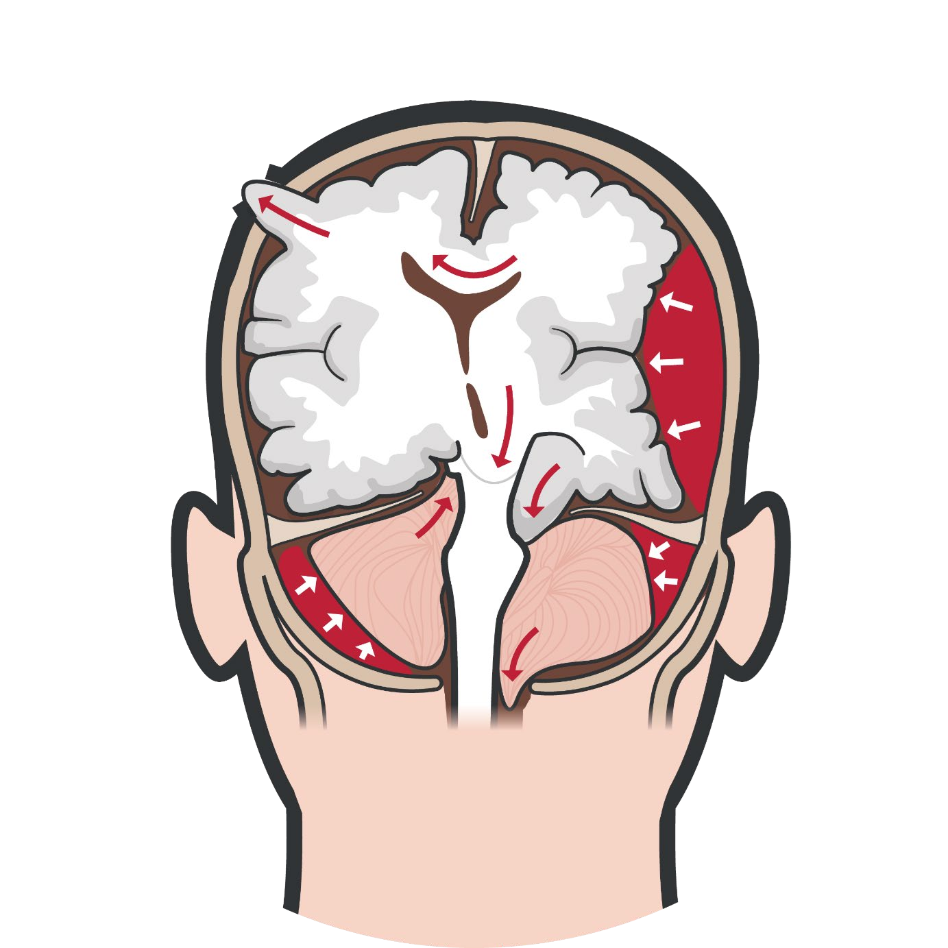
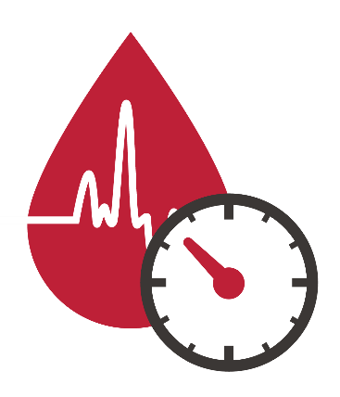



SIGNS AND SYMPTOMS OF IMPENDING CEREBRAL HERNIATION
Module 13: Head Injuries
CUSHING’S TRIAD
HIGH PULSE PRESSURE
LOW HEART RATE
IRREGULAR RESPIRATIONS
Increased Intracranial Pressure | Impending Cerebral Herniation
Severe Headaches | Unilateral pupillary dilation (blown or fixed pupils)
Nausea and/or vomiting | Focal neurologic signs
Altered mental status | Acute loss of consciousness
Deteriorating level of consciousness | Decorticate and/or Decerebrate
Seizures
Cushing’s triad
Signs of impending brain herniation are an indication for URGENT EVACUATION
Level of Evidence: C-LD
Notes:
Brain herniation is a potentially deadly side effect of head injury or traumatic brain injury that occurs when a part of the brain is squeezed across fixed structures within the skull or dura matter, through a defect in the skull (from an open skull fracture or penetrating wound), or through the hole in the base of the skull where the spinal cord connects with the brain.⁶¹
In the combat or trauma setting, herniation can result due to mass effect from intracranial bleeding or increased intracranial pressure caused by swelling associated with traumatic brain injury (TBI). Depending on the area of the brain that is herniating, the presenting symptoms may vary. Some relate to autonomic nervous system abnormalities (changes in respiratory and circulatory parameters), some relate to diffuse increased pressure (changes in mentation, constitutional symptoms like nausea or headaches), and others relate to compromise to specific areas of the brain (focal neurologic findings).⁶²
Signs and symptoms related to the increased ICP, with the potential for impending herniation, include:
Severe Headaches
Nausea and/or vomiting
Altered mental status/deteriorating level of consciousness
Seizures
Cushing’s triad, which is a widened pulse pressure, bradycardia, and irregular respirations (also known as Cheyne–Stokes respirations, consisting of periods of slow, deep breaths followed by periods of apnea)⁶³
Signs and symptoms related to ongoing herniation include:
Unilateral pupillary dilation (a blown or fixed pupils that does not react to light)
Focal neurologic signs (often weakness or paralysis)
Acute loss of consciousness
Abnormal body posturing, a characteristic positioning of the limbs, indicative of severe brain damage (decerebrate or decorticate posturing)⁶⁴
Signs of impending brain herniation must be addressed as soon as possible and are an indication for urgent evacuation to a higher level of medical care.
More advanced treatments and interventions are addressed in the Tactical Evacuation (TACEVAC) phase of Tactical Combat Casualty Care (TCCC).
The level of evidence supporting the guidance for the identification of impending cerebral herniation is based on retrospective observational registry studies.

Slide 16
INDICATIONS AND ADMINISTRATION OF HYPERTONIC SALINE
Module 13: Head Injuries
CONTRAINDICATIONS:
Hypersensitivity and infusion reactions
History of cardiac disease Heart Failure
Some Endocrine disorders Electrolyte imbalances
Elevate casualty's head 30 degrees Hyperventilate at 20 breaths per minute End-tidal CO2 goal 32-38 mmHg Highest oxygen concentration possible
Hypertonic Saline is indicated for signs of impending cerebral herniation
Administer 30 ml 23.4% hypertonic saline slow IV/IO push over 10 minutes followed by a saline flush
OR
250 ml of 3% or 5% hypertonic saline IV/IO bolus
IMPORTANT CONSIDERATION:
Do not hyperventilate the casualty unless signs of impending herniation are present
Level of Evidence: B-R
Notes:
Hypertonic saline is a hyperosmolar therapy that is used in traumatic brain injury to reduce intracranial pressure.⁶⁵ Currently, there are three primary indications for its use: hyponatremia, volume resuscitation, and brain injury.⁶⁶ More specifically, in brain injury, the indication for using hypertonic saline is the presence of any of the signs of increased intracranial pressure or suspicion of impending cerebral herniation.
Contraindications include hypersensitivity and infusion reactions, but there are several relative contraindications that may be outweighed by the need to treat the elevated ICP or prevent cerebral herniation. Those include a history of cardiac disease, heart failure, some endocrine disorders, and electrolyte imbalances.⁶⁷
The mechanism of action, as it relates to ICP, is to reduce cerebral edema by establishing an osmotic gradient in the brain that facilitates a reduction in pressure as fluid in the interstitial spaces is offloaded.^{68,69,70} The duration of action varies but is likely about 3 hours.^{71,72}
The TCCC Guidelines, in the Tactical Evacuation Care section, outline the method of administration in the Tactical Evacuation Care Basic Management Plan as administering 250 ml of 3 or 5% hypertonic saline via IV/IO bolus.⁷³ The JTS clinical practice guidelines indicate the bolus should occur over about 20 minutes and can be repeated every 3 hours, as needed.⁷⁴
So, 23.4% hypertonic saline is an attractive option because it has a lighter weight (80g) and pack volume (55cm³), and it provides a similar osmotic load per dose.⁷⁵ This more concentrated dose is administered as a 30 mL slow IV/IO push over 10 minutes followed by a saline flush and can be repeated in 20 minutes if no response (max 2 doses).
Of course, the other treatments for increased ICP, like elevating the casualty’s head 30 degrees if the patient is not in shock and tactically feasible, using supplemental oxygen to keep the SpO₂ >90%, and ventilating the casualty to maintain an EtCO₂ from 25-30mmHg, should also be done concurrently with the administration of the hypertonic saline.
Hyperventilation at 20 breaths per minute is recommended to attain the EtCO₂ goal, unless signs of impending herniation are present, in which case the rate can be higher for a short period of time.
The level of evidence supporting the guidance for the use of hypertonic saline in increased ICP treatment is based on retrospective descriptions and expert opinions.

Slide 17

Module 13: Head Injuries
TBI AND TACTICAL EVACUATION CARE
Monitor casualties with signs and symptoms of Moderate/Severe TBI for: | For casualties with Impending Cerebral Herniation, take the following actions:
Decreases in level of consciousness | Administer 30 ml 23.4% hypertonic saline slow IV/IO push or 250 ml of 3% or 5% hypertonic saline IV/IO bolus
Pupillary dilation | Elevate the casualty’s head 30 degrees
SBP (maintain 100-110mmHg) | Hyperventilate the casualty (RR 20 breaths/min)
O2 Sat (should be > 90%) | Maintain end-tidal CO2 between 32-38 mmHg
Hypothermia | Use highest oxygen concentration possible
End-tidal CO2 (maintain between 32-38 mmHg)
Penetrating head trauma (if present, administer antibiotics) | NOTE: Unilateral pupillary dilation accompanied by a decreased level of consciousness, may signify impending cerebral herniation.
Assume a spinal (neck) injury until cleared
Notes:
Although the focus of this module is on head injuries in the Tactical Field Care setting, as Combat Paramedics and Providers you may also be involved in more prolonged field care settings and/or in the Tactical Evacuation Care phase of casualty management. So, as a quick introduction, it might be helpful to understand the TCCC Guidelines for TBI in the evacuation phase:⁵⁶
Casualties with moderate/severe TBI should be monitored for:
Decreases in level of consciousness
Pupillary dilation
SBP (maintain 100-110mmHg)
O₂ sat > 90
Hypothermia
End-tidal CO₂ (If capnography is available, maintain between 32-38 mmHg)
Penetrating head trauma (if present, administer antibiotics)
Assume a spinal (neck) injury until cleared.
Unilateral pupillary dilation accompanied by a decreased level of consciousness may signify impending cerebral herniation; if these signs occur, take the following actions to decrease intracranial pressure:
Administer 250 ml of 3 or 5% hypertonic saline IV/IO bolus or 30 ml 23.4% hypertonic saline slow IV/IO push
Elevate the casualty’s head 30 degrees
Hyperventilate the casualty to a respiratory rate of 20 breaths/minute
Capnography should be used to maintain the end-tidal CO₂ between 32-38 mmHg
The highest oxygen concentration (FIO₂) possible should be used for hyperventilation
Do not hyperventilate the casualty unless signs of impending herniation are present. Casualties may be hyperventilated with oxygen using the bag valve mask technique

Slide 18
Module 13: Head Injuries
EVIDENCE SUPPORTING
HEAD INJURY MANAGEMENT STRATEGIES
Subject Category | Study Types | Level of Evidence
Use of MACE 2 in TBI Assessment | Clinical Consensus, Expert Opinion & Discussion | C-EO
Basic Management of Suspected Head Injuries | Retrospective Reviews & Some Prospective Studies | C-LD
Identification of Impending Cerebral Herniation | Retrospective Observational Registry Study | C-LD
Use of Hypertonic Saline in Increased ICP Treatment | Retrospective Descriptions & Subject Expert Opinion | B-R
Notes:
The identification of head injuries and the forces that cause them have been very well studied in both civilian and military settings, and are well accepted by academia, professional organizations, and subject matter experts alike.
The use of the MACE 2 form for establishing a baseline and determining the likely degree of injury has not been studied in depth, to date. But the individual sections of the evaluation and their significance has been established in other non-combat settings and is supported by a fair degree of supporting evidence.^{77,78,79} The original MACE process was reviewed in combat settings and it was established that the findings are less reliable if the exam is administered more than 12 hours after the event.⁸⁰ Overall, the level of supporting evidence is low to moderate.
The basic management of suspected head injuries draws from a multitude of civilian and several military studies and involves varying levels of evidence supporting each of the recommended actions to be taken during the overall course of treatment. So, although some areas have less robust information, the overall level of supporting evidence is moderate to high.
The identification of impending cerebral herniation has been well-studied over the years, and there is no difference between the signs and symptoms noted in civilian trauma victims and military trauma casualties. The overall level of evidence to support the recommendations for identification and monitoring of cerebral herniation is moderate to high.
Several studies have looked at the use of hypertonic saline as part of the management plan for controlling increased intracerebral pressure, although few of them have been in the military setting and/or prehospital trauma setting, with more research having been accomplished in the inpatient setting. Subject matter opinion is that the lessons learned in the hospital should translate to comparable results in the prehospital setting. So, the overall level of supporting evidence is based on subject expert opinion and retrospective descriptive studies, resulting in a low to moderate level of confidence.

Slide 19

Module 13: Head Injuries
ASSESSING THE EVIDENCE FOR GUIDELINES
Level of Evidence | AHA Recommendation System Terminology Explanation | Why the AHA Classification System?
A | Evidence from multiple randomized clinical trials (RCT) with concordant results or from HIGH-QUALITY meta-analyses. | The level of evidence recommendations allow readers to quickly glean information on the strength, certainty, and quality of evidence supporting each recommendation. A recommendation with Level of Evidence (LOE) C does not imply that the recommendation is weak. Although, RCTs are unavailable, there may be a very clear clinical consensus that a particular test or therapy is useful or effective.
B-R | Evidence from moderate-quality trials, or a meta-analysis of moderate quality (RCT) followed by an R to denote RANDOMIZED studies
B-NR | Evidence from moderate-quality trials, or a meta-analysis of moderate quality followed by NR to denote NON-RANDOMIZED studies
C-LD | There is no convincing evidence and is followed by LD to indicate LIMITED DATA
C-EO | There is no convincing evidence and is followed by EO if the consensus is based on EXPERT OPINION, case studies or standards of care.
Notes:
Evidence-based recommendations and guidance are the result of a careful review of studies and discussion by a panel of subject matter experts. For TCCC, the subject matter expert panels include both Committee on TCCC members and select invited subject matter experts from within both the military and civilian community, based on the specific interest area.
Why the AHA Classification System?
The level of evidence classification combines an objective description of the existence and the types of studies supporting the recommendation and expert consensus, according to 1 of the following 3 categories:⁶¹
Level of evidence A: recommendation based on evidence from multiple randomized trials or meta-analyses
Level of evidence B: recommendation based on evidence from a single randomized trial or nonrandomized studies
Level of evidence C: recommendation based on expert opinion, case studies, or standards of care.
The level of evidence recommendations allows readers to quickly glean information on the strength, certainty, and quality of evidence supporting each recommendation. The Level of Evidence (LOE) denotes the confidence in or certainty of the evidence supporting the recommendation, based on the type, size, quality, and consistency of pertinent research findings.⁶²
A recommendation with level of evidence C does not imply that the recommendation is weak. Many important clinical questions addressed in guidelines do not lend themselves to clinical trials. Although, Randomized Clinical Trials are unavailable, there may be a very clear clinical consensus that a particular test or therapy is useful or effective.

Slide 20
SUMMARY
Module 13: Head Injuries
Knowledge Topics
Signs and symptoms of head injuries
Mechanisms of head injuries
Indications for performing a MACE 2 evaluation for casualties suspected of head injury/TBI
Management of suspected head injury in Tactical Field Care
Signs and symptoms of impending cerebral herniation in Tactical Field Care
Use of hypertonic saline to treat increased intracranial pressure
Level of evidence supporting traumatic brain injury management strategies
Notes:
We began by reviewing the signs and symptoms that are seen with head injuries and talked about the external forces that can cause those injuries.
We identified the indications for performing a Military Acute Concussive Evaluation 2 (MACE 2) for a casualty with a suspected head injury. And then, we discussed the progressive strategies and constraints for management of a suspected head injury.
After identifying the signs and symptoms of impending cerebral herniation, we talked about the indications, contraindications, and administration methods of hypertonic saline in suspected traumatic brain injury.
Lastly, we described the evidence supporting the strategies and recommendations for assessing and treating head injuries and suspected TBI.

Slide 21

CHECK ON LEARNING
Module 13: Head Injuries
What external forces can cause a head injury?
What are the critical observations that should be reported to medical personnel for trauma casualties with a suspected head injury, in accordance with the Military Acute Concussive Evaluation 2 (MACE 2)?
What is the goal of management of casualties with suspected head injury/TBI in TFC?
What are the methods of administration for Hypertonic Saline for a casualty with impending cerebral herniation?
Notes:
To close out this module, check your learning with the questions below (answers under the image).
Answers
What external forces can cause a head injury?
Involvement in a vehicle blast event, collision, or rollover
The presence within 50 METERS of a blast (inside or outside)
A direct blow to the head or a fall
Gunshot or shrapnel wound to the head, open skull fracture, or witnessed loss of consciousness
Exposure to more than one blast event (the Service member’s commander will direct a medical evaluation)
What are the critical observations or red flags that may prompt urgent evacuation to a higher level of medical care for trauma casualties with a suspected head injury, in accordance with the Military Acute Concussive Evaluation 2 (MACE 2)?
Deteriorating level of consciousness
Double vision
Increased restlessness; combative or agitated behavior
Repeat vomiting
Results from a structural brain injury detection device (if available)
Seizures
Weakness or tingling in arms or legs
Severe or worsening headache
What is the goal of management for casualties with suspected head injuries/TBI in TFC?
Prevention of secondary brain injury from hypotension and hypoxia
What are the methods of administration for Hypertonic Saline for a casualty with impending cerebral herniation?
30 ml 23% hypertonic saline slow IV/IO push
Administer 250 ml of 3% or 5% hypertonic saline IV/IO bolus OR

Slide 22




Module 13: Head Injuries
ANY QUESTIONS?

Slide 23

REFERENCES
Module 13: Head Injuries
TCCC: Guidelines
by JTS/CoTCCC
These guidelines, updated regularly, are the result of decisions made by CoTCCC in exploring evidence-based research on best practices.
PHTLS: Military Edition, Chapter 25
by NAEMT
Prehospital Trauma Life Support (PHTLS), Military Edition, teaches and reinforces the principles of rapidly assessing a trauma patient using an orderly approach.
Notes:
¹ Shaikh F, Waseem M. Head Trauma. [Updated 2021 Nov 7]. In: StatPearls [Internet]. Treasure Island (FL): StatPearls Publishing; 2022 Jan-. Available from: https://www.ncbi.nlm.nih.gov/books/NBK430854/; accessed on 27 Mar 22.
² Galgano M, Toshkezi G, Qiu X, Russell T, Chin L, Zhao LR. Traumatic Brain Injury: Current Treatment Strategies and Future Endeavors. Cell Transplant. 2017 Jul;26(7): 1118-1130.
³ van Wyck D, Loos PE, Friedline N, Stephens D, Smedick BC, McCafferty R, Rush SC, Keenan S, Powell D, Shackelford S. Traumatic Brain Injury Management in Prolonged Field Care. J Spec Oper Med. 2017 Fall;17(3): 130-140.
⁴ Georges A, M Das J. Traumatic Brain Injury. [Updated 2022 Jan 5]. In: StatPearls [Internet]. Treasure Island (FL): StatPearls Publishing; 2022 Jan-. Available from: https://www.ncbi.nlm.nih.gov/books/NBK459300/; accessed 27 Mar 22.
⁵ DOD Instruction 6940.11. DoD Policy Guidance for Management of Mild Traumatic Brain Injury/Concussion in the Deployed Setting. Available at https://www.esd.whs.mil/Portals/54/Documents/DD/issuances/dodi/649011p.pdf; accessed 28 Mar 22.
⁶ van Wyck D, Loos PE, Friedline N, Stephens D, Smedick BC, McCafferty R, Rush SC, Keenan S, Powell D, Shackelford S. Traumatic Brain Injury Management in Prolonged Field Care. J Spec Oper Med. 2017 Fall;17(3): 130-140.
⁷ Rutland-Brown W, Langlois JA, Nicaj L, et al. Traumatic brain injuries after mass-casualty incidents: lessons from the 11 September 2001 World Trade Center attacks. Prehosp Disast Med. 2007;22(3): 157-164.
⁸ Xydakis MS, Ling GS, Mulligan LP, et al. Epidemiologic aspects of traumatic brain injury in acute combat casualties at a major military medical center: a cohort study. Ann Neurol. 2012;72(5): 673-681.
⁹ DOD Instruction 6940.11. DoD Policy Guidance for Management of Mild Traumatic Brain Injury/Concussion in the Deployed Setting. Available at https://www.esd.whs.mil/Portals/54/Documents/DD/issuances/dodi/649011p.pdf; accessed 28 Mar 22.
¹⁰ Provider Resources. Traumatic Brain Injury Center of Excellence. Available at https://health.mil/Military-Health-Topics/Centers-of-Excellence/Traumatic-Brain-Injury-Center-of-Excellence/Provider-Resources; accessed 28 Mar 22.
¹¹ DoD standard surveillance case definition for TBI adapted for AFHSB use. Military Health System website. Available at: https://www.health.mil/Military-Health-Topics/Combat-Support/Armed-Forces-Health-Surveillance-Division/Epidemiology-and-Analysis/Surveillance-Case-Definitions; accessed 28 Mar 22.
¹² Mucha, A., et al. A brief vestibular/ocular motor screening (VOMS) assessment to evaluate concussions preliminary findings. American Journal of Sports Medicine. 2014, 40(10), 2479-2486.
¹³ MACE 2 Instructor Guide. Traumatic Brain Injury Center of Excellence. Available at https://health.mil/Reference-Center/Publications/2020/07/31/MACE-2-Provider-Training-Instructor-Guide; accessed 28 Mar 22.
¹⁴ DOD TBI Worldwide Numbers. Traumatic Brain Injury Center of Excellence. Available at https://health.mil/Military-Health-Topics/Centers-of-Excellence/Traumatic-Brain-Injury-Center-of-Excellence/DOD-TBI-Worldwide-Numbers; accessed 28 Mar 22.
¹⁵ van Wyck D, Loos PE, Friedline N, Stephens D, Smedick BC, McCafferty R, Rush SC, Keenan S, Powell D, Shackelford S. Traumatic Brain Injury Management in Prolonged Field Care. J Spec Oper Med. 2017 Fall;17(3): 130-140.
¹⁶ Carney N, et al. Guidelines for the Management of Severe Traumatic Brain Injury, Fourth Edition. Neurosurgery. 2017 Jan 1;80(1): 6-15.
¹⁷ The Management of Traumatic Brain Injury in Tactical Combat Casualty Care. Defense Health Board. 26 Jul 2012. Available at: https://www.google.com/url?sa=t&rct=j&q=&esrc=s&source=web&cd=&ved=2ahUKEwj5sNvb1ur2AhWlVt8KHdRHCXIQFnoECAMQAQ&url=https%3A%2F%2Fhealth.mil%2FReference-Center%2FReports%2F2012%2F07%2F26%2FManagement-of-Traumatic-Brain-Injury-in-Tactical-Combat-Casualty-Care&usg=AOvVaw0PaZ9o7MxD465wfLER4Com; accessed 28 Mar 22.
¹⁸ Tactical Combat Casualty Care Guidelines, 15 Dec 2021. Basic Management Plan for Tactical Field Care; https://deployedmedicine.com/market/31/content/40, accessed 28 Mar 22.
¹⁹ Ammar A. Prehospital Care for Head Trauma. Asian J Neurosurg. 2018;13(3): 955-956.
²⁰ Chowdhury T, Kowalski S, Arabi Y, Dash HH. Pre-hospital and initial management of head injury patients: An update. Saudi J Anaesth. 2014;8(1): 114-120.
²¹ Groswasswer Z, Cohen M, Blankstein E. Polytrauma associated with traumatic brain injury: incidence, nature and impact on rehabilitation outcome. Brain Inj. 1990;4(2): 161–166.
²² Manley G, Knudson MM, Morabito D, et al. Hypotension, hypoxia, and head injury: frequency, duration, and consequences. Arch Surg. 2001;136(10): 1118-1123.
²³ Spaite DW, Hu C, Bobrow BJ, et al. Association of out-of-hospital hypotension depth and duration with traumatic brain injury mortality. Ann Emerg Med. 2017 Oct;70(4): 522-530.
²⁴ Yokobori S, Yatabe T, Kondo Y, Kinoshita K; Japan Resuscitation Council (JRC) Neuroresuscitation Task Force and the Guidelines Editorial Committee. Efficacy and safety of tranexamic acid administration in traumatic brain injury patients: a systematic review and meta-analysis. J Intensive Care. 2020 Jul 3; 8:46.
²⁵ CRASH-3 trial collaborators. Effects of tranexamic acid on death, disability, vascular occlusive events and other morbidities in patients with acute traumatic brain injury (CRASH-3): a randomized, placebo-controlled trial. Lancet. 2019 Nov 9;394(10210): 1713-1723.
²⁶ Rowell SE, Meier EN, McKnight B, et al. Effect of Out-of-Hospital Tranexamic Acid vs Placebo on 6-Month Functional Neurologic Outcomes in Patients with Moderate or Severe Traumatic Brain Injury. JAMA. 2020;324(10): 961–974.
²⁷ Abdelmalik PA, Draghic N, Ling GSF. Management of moderate and severe traumatic brain injury. Transfusion. 2019 Apr; 59(S2): 1529-1538.
²⁸ Vella MA, Crandall ML, Patel MB. Acute Management of Traumatic Brain Injury. Surg Clin North Am. 2017 Oct: 97(5): 1015-1030.
²⁹ Brenner M, Stein DM, Hu PF, et al. Traditional systolic blood pressure targets underestimate hypotension-induced secondary brain injury. J Trauma Acute Care Surg. 2012;72(5):1135–1139.
³⁰ Van Wyck DW, Grant GA, Laskowitz DT. Penetrating traumatic brain injury: a review of current evaluation and management concepts. J Neurol Neurophysiol. 2015;6(6):1–7.
³¹ Porter K. Ketamine in prehospital care. Emerg Med J. 2004;21: 351–354.
³² Davis DP, Peay J, Sise MJ, et al. Pre-hospital airway and ventilation management: a trauma score and injury severity score-based index analysis. J Trauma. 2010;69(2):294–301.
³³ Stocchetti N, Maas A, Chieregato A, et al. Hyperventilation in head injury. Chest. 2005;127(5): 1812–1827.
³⁴ Minardi J, Crocco TJ. Management of traumatic brain injury: first link in chain of survival. Mt Sinai J Med. 2009 Apr;76(2): 138-44.
³⁵ Meyer MJ, et al. Acute management of acquired brain injury part I: an evidence-based review of non-pharmacological interventions. Brain Inj. 2010;24(5): 694-705.
³⁶ Feldman Z, Kanter MJ, Robertson CS, Contant CF, Hayes C, Sheinberg MA, Villareal CA, Narayan RK, Grossman RG. Effect of head elevation on intracranial pressure, cerebral perfusion pressure, and cerebral blood flow in head-injured patients. J Neurosurg. 1992;76(2): 207–211.
³⁷ Jeremitsky E, Omert L, Dunham CM, Protetch J, Rodriguez A. Harbingers of poor outcome the day after severe brain injury: hypothermia, hypoxia, and hypoperfusion. J Trauma. 2003 Feb;54(2):312-9.
³⁸ Konstantinidis A, Inaba K, Dubose J, Barmparas G, Talving P, David JS, Lam L, Demetriades D. The impact of nontherapeutic hypothermia on outcomes after severe traumatic brain injury. J Trauma. 2011 Dec;71(6): 1627-31.
³⁹ Marut D, Shammassian B, McKenzie C, Adamski J, Traeger J. Evaluation of prophylactic antibiotics in penetrating brain injuries at an academic level 1 trauma center. Clin Neurol Neurosurg. 2020 Jun;193: 105777.
⁴⁰ Kazim SF, Shamim MS, Tahir MZ, Enam SA, Waheed S. Management of penetrating brain injury. J Emerg Trauma Shock. 2011;4(3)3 95-402.
⁴¹ Munakomi S, M Das J. Brain Herniation. [Updated 2022 Feb 9]. In: StatPearls [Internet]. Treasure Island (FL): StatPearls Publishing; 2022 Jan-. Available from: https://www.ncbi.nlm.nih.gov/books/NBK542246/; accessed 27 Mar 22.
⁴² Stevens RD, Shoykhet M, Cadena R. Emergency Neurological Life Support: Intracranial Hypertension and Herniation. Neurocrit Care. 2015;23 Suppl 2(Suppl 2): S76-S82.
⁴³ Cushing H. Concerning a definite regulatory mechanism of the vasomotor centre which controls blood pressure during cerebral compression. Bull Johns Hopkins Hosp. 1901;126: 289–292.
⁴⁴ Knight J, Decker LC. Decerebrate And Decorticate Posturing. [Updated 2021 Nov 30]. In: StatPearls [Internet]. Treasure Island (FL): StatPearls Publishing; 2022 Jan-. Available from: https://www.ncbi.nlm.nih.gov/books/NBK559135/; accessed 29 Mar 22.
⁴⁵ Chen H, Song Z, Dennis JA. Hypertonic saline versus other intracranial pressure–lowering agents for people with acute traumatic brain injury. Cochrane Database of Systematic Reviews 2019, Issue 12. Art. No.: CD010904. DOI: 10.1002/14651858.CD010904.pub2. Accessed 27 March 2022.
⁴⁶ Johnson AL, Criddle LM. Pass the salt: indications for and implications of using hypertonic saline. Crit Care Nurse. 2004 Oct;24(5):36-8, 40-4, 46.
⁴⁷ Sodium chloride - Drug Summary. PDR net. Available at: https://www.pdr.net/drug-summary/Sodium-Chloride-sodium-chloride-24245; accessed 29 Mar 22.
⁴⁸ Shi J, Tan L, Ye J, Hu L. Hypertonic saline and mannitol in patients with traumatic brain injury: A systematic and meta-analysis. Medicine (Baltimore). 2020;99(35): e21655.
⁴⁹ Fatima N, Ayyad A, Shuaib A, Saqqur M. Hypertonic Solutions in Traumatic Brain Injury: A Systematic Review and Meta-Analysis. Asian J Neurosurg. 2019;14(2): 382-391.
⁵⁰ Roquilly A, Moyer JD, Huet O, et al. Effect of Continuous Infusion of Hypertonic Saline vs Standard Care on 6-Month Neurological Outcomes in Patients With Traumatic Brain Injury: The COBI Randomized Clinical Trial. JAMA. 2021;325(20): 2056–2066.
⁵¹ Berger-Pelleiter, E., Émond, M., Lauzier, F., Shields, J., & Turgeon, A. (2016). Hypertonic saline in severe traumatic brain injury: A systematic review and meta-analysis of randomized controlled trials. CJEM, 18(2), 112-120.
⁵² Rossong H, Hasen M, Ahmed B, Zeiler FA, Dhaliwal P. Hypertonic Saline for Moderate Traumatic Brain Injury: A Scoping Review of Impact on Neurological Deterioration. Neurotrauma Reports. Jan 2020: 253-260.
⁵³ Tactical Combat Casualty Care Guidelines, 15 Dec 2021. Basic Management Plan for Tactical Evacuation Care. Paragraph 6. https://deployedmedicine.com/market/31/content/40, accessed 29 Mar 22.
⁵⁴ van Wyck D, Loos PE, Friedline N, Stephens D, Smedick BC, McCafferty R, Rush SC, Keenan S, Powell D, Shackelford S. Traumatic Brain Injury Management in Prolonged Field Care. J Spec Oper Med. 2017 Fall;17(3): 130-140.
⁵⁵ DeSoucy ES, Cacic K, Staak BP, Petersen CD, van Wyck D, Rajajee V, Dorsch J, Rush SC. 23.4% Hypertonic Saline: A Tactical Option for the Management of Severe Traumatic Brain Injury With Impending or Ongoing Herniation. J Spec Oper Med. 2021 Summer;21(2):25-28.
⁵⁶ Tactical Combat Casualty Care Guidelines, 15 Dec 2021. Basic Management Plan for Tactical Evacuation Care. Paragraph 6. https://deployedmedicine.com/market/31/content/40, accessed 29 Mar 22.
⁵⁷ Mucha, A., et al. A brief vestibular/ocular motor screening (VOMS) assessment to evaluate concussions preliminary findings. American Journal of Sports Medicine, (2014); 40(10), 2479-2486.
⁵⁸ McCrory P, Meeuwisse W, Dvorak J, et al. Consensus statement on concussion in sport—the 5th international conference on concussion in sport held in Berlin, October 2016.cBritish Journal of Sports Medicine 2017;51: 838-847.
⁵⁹ Lindberg MA, Kiser SA, Moy Martin EM. Mild TBI/Concussion Clinical Tools for Providers Used Within the Department of Defense and Defense Health Agency. Fed Pract. 2020;37(9): 410-419.
⁶⁰ Coldren RL, Kelly MP, Parish RV, Dretsch M, Russell ML. Evaluation of the Military Acute Concussion Evaluation for use in combat operations more than 12 hours after injury. Mil Med. 2010 Jul;175(7):477-81.
⁶¹ Tricoci P, Allen JM, Kramer JM, Califf RM, Smith Jr SC. Scientific Evidence Underlying the ACC/AHA Clinical Practice Guidelines. American Medical Association. 2009 Feb; Vol 301, No. 8.
⁶² Halparin, JL. Further Evolution of the ACC/AHA Clinical Practice Guideline Recommendation Classification System. American College of Cardiology Foundation and the American Heart Association. 2016 Apr; 133:1426-1428.
Evidence Based References
Abdelmalik PA, Draghic N, Ling GSF. Management of moderate and severe traumatic brain injury. Transfusion. 2019 Apr; 59(S2): 1529-1538 B-R
Ammar A. Prehospital Care for Head Trauma. Asian J Neurosurg. 2018;13(3): 955-956 C-EO
Berger-Pelleiter, E., Émond, M., Lauzier, F., Shields, J., & Turgeon, A. (2016). Hypertonic saline in severe traumatic brain injury: A systematic review and meta-analysis of randomized controlled trials. CJEM, 18(2), 112-120 B-R
Brenner M, Stein DM, Hu PF, et al. Traditional systolic blood pressure targets underestimate hypotension-induced secondary brain injury. J Trauma Acute Care Surg. 2012;72(5):1135–1139 B-R
Chen H, Song Z, Dennis JA. Hypertonic saline versus other intracranial pressure–lowering agents for people with acute traumatic brain injury. Cochrane Database of Systematic Reviews 2019, Issue 12 B-R
Chowdhury T, Kowalski S, Arabi Y, Dash HH. Pre-hospital and initial management of head injury patients: An update. Saudi J Anaesth. 2014;8(1): 114-120 B-R
Coldren RL, Kelly MP, Parish RV, Dretsch M, Russell ML. Evaluation of the Military Acute Concussion Evaluation for use in combat operations more than 12 hours after injury. Mil Med. 2010 Jul;175(7):477-81 B-NR
CRASH-3 trial collaborators. Effects of tranexamic acid on death, disability, vascular occlusive events and other morbidities in patients with acute traumatic brain injury (CRASH-3): a randomized, placebo-controlled trial. Lancet. 2019 Nov 9;394(10210): 1713-1723 A
Cushing H. Concerning a definite regulatory mechanism of the vasomotor centre which controls blood pressure during cerebral compression. Bull Johns Hopkins Hosp. 1901;126: 289–292 C-LD
Davis DP, Peay J, Sise MJ, et al. Pre-hospital airway and ventilation management: a trauma score and injury severity score-based index analysis. J Trauma. 2010;69(2):294–301 C-LD
DeSoucy ES, Cacic K, Staak BP, Petersen CD, van Wyck D, Rajajee V, Dorsch J, Rush SC. 23.4% Hypertonic Saline: A Tactical Option for the Management of Severe Traumatic Brain Injury With Impending or Ongoing Herniation. J Spec Oper Med. 2021 Summer;21(2):25-28 B-NR
Fatima N, Ayyad A, Shuaib A, Saqqur M. Hypertonic Solutions in Traumatic Brain Injury: A Systematic Review and Meta-Analysis. Asian J Neurosurg. 2019;14(2): 382-391 B-R
Feldman Z, Kanter MJ, Robertson CS, Contant CF, Hayes C, Sheinberg MA, Villareal CA, Narayan RK, Grossman RG. Effect of head elevation on intracranial pressure, cerebral perfusion pressure, and cerebral blood flow in head-injured patients. J Neurosurg. 1992;76(2): 207–211 B-NR
Galgano M, Toshkezi G, Qiu X, Russell T, Chin L, Zhao LR. Traumatic Brain Injury: Current Treatment Strategies and Future Endeavors. Cell Transplant. 2017 Jul;26(7): 1118-1130. C-LD
Groswasswer Z, Cohen M, Blankstein E. Polytrauma associated with traumatic brain injury: incidence, nature and impact on rehabilitation outcome. Brain Inj. 1990;4(2): 161–166 C-LD
Jeremitsky E, Omert L, Dunham CM, Protetch J, Rodriguez A. Harbingers of poor outcome the day after severe brain injury: hypothermia, hypoxia, and hypoperfusion. J Trauma. 2003 Feb;54(2):312-9 C-LD
Johnson AL, Criddle LM. Pass the salt: indications for and implications of using hypertonic saline. Crit Care Nurse. 2004 Oct;24(5):36-8, 40-4, 46 B-R
Kazim SF, Shamim MS, Tahir MZ, Enam SA, Waheed S. Management of penetrating brain injury. J Emerg Trauma Shock. 2011;4(3)3 95-402 C-EO
Konstantinidis A, Inaba K, Dubose J, Barmparas G, Talving P, David JS, Lam L, Demetriades D. The impact of nontherapeutic hypothermia on outcomes after severe traumatic brain injury. J Trauma. 2011 Dec;71(6): 1627-31 C-LD
Lindberg MA, Kiser SA, Moy Martin EM. Mild TBI/Concussion Clinical Tools for Providers Used Within the Department of Defense and Defense Health Agency. Fed Pract. 2020;37(9): 410-419 C-EO
Manley G, Knudson MM, Morabito D, et al. Hypotension, hypoxia, and head injury: frequency, duration, and consequences. Arch Surg. 2001;136(10): 1118-1123 B-NR
Marut D, Shammassian B, McKenzie C, Adamski J, Traeger J. Evaluation of prophylactic antibiotics in penetrating brain injuries at an academic level 1 trauma center. Clin Neurol Neurosurg. 2020 Jun;193: 105777 C-LD
McCrory P, Meeuwisse W, Dvorak J, et al. Consensus statement on concussion in sport—the 5th international conference on concussion in sport held in Berlin, October 2016.cBritish Journal of Sports Medicine 2017;51: 838-847 C-EO
Meyer MJ, et al. Acute management of acquired brain injury part I: an evidence-based review of non-pharmacological interventions. Brain Inj. 2010;24(5): 694-705 B-R
Minardi J, Crocco TJ. Management of traumatic brain injury: first link in chain of survival. Mt Sinai J Med. 2009 Apr;76(2): 138-44 B-R
Mucha, A., et al. A brief vestibular/ocular motor screening (VOMS) assessment to evaluate concussions preliminary findings. American Journal of Sports Medicine, (2014); 40(10), 2479-2486 B-R
Mucha, A., et al. A brief vestibular/ocular motor screening (VOMS) assessment to evaluate concussions preliminary findings. American Journal of Sports Medicine. 2014, 40(10), 2479-2486 C-LD
Porter K. Ketamine in prehospital care. Emerg Med J. 2004;21: 351–354. C-EO
Roquilly A, Moyer JD, Huet O, et al. Effect of Continuous Infusion of Hypertonic Saline vs Standard Care on 6-Month Neurological Outcomes in Patients With Traumatic Brain Injury: The COBI Randomized Clinical Trial. JAMA. 2021;325(20): 2056–2066 B-R
Rossong H, Hasen M, Ahmed B, Zeiler FA, Dhaliwal P. Hypertonic Saline for Moderate Traumatic Brain Injury: A Scoping Review of Impact on Neurological Deterioration. Neurotrauma Reports. Jan 2020: 253-260 B-R
Rowell SE, Meier EN, McKnight B, et al. Effect of Out-of-Hospital Tranexamic Acid vs Placebo on 6-Month Functional Neurologic Outcomes in Patients with Moderate or Severe Traumatic Brain Injury. JAMA. 2020;324(10): 961–974 A
Rutland-Brown W, Langlois JA, Nicaj L, et al. Traumatic brain injuries after mass-casualty incidents: lessons from the 11 September 2001 World Trade Center attacks. Prehosp Disast Med. 2007;22(3): 157-164 C-LD
Shi J, Tan L, Ye J, Hu L. Hypertonic saline and mannitol in patients with traumatic brain injury: A systematic and meta-analysis. Medicine (Baltimore). 2020;99(35): e21655 B-R
Spaite DW, Hu C, Bobrow BJ, et al. Association of out-of-hospital hypotension depth and duration with traumatic brain injury mortality. Ann Emerg Med. 2017 Oct;70(4): 522-530 C-LD
Stevens RD, Shoykhet M, Cadena R. Emergency Neurological Life Support: Intracranial Hypertension and Herniation. Neurocrit Care. 2015;23 Suppl 2(Suppl 2): S76-S82 C-EO
Stocchetti N, Maas A, Chieregato A, et al. Hyperventilation in head injury. Chest. 2005;127(5): 1812–1827 B-R
van Wyck D, Loos PE, Friedline N, Stephens D, Smedick BC, McCafferty R, Rush SC, Keenan S, Powell D, Shackelford S. Traumatic Brain Injury Management in Prolonged Field Care. J Spec Oper Med. 2017 Fall;17(3): 130-140 C-EO
Van Wyck DW, Grant GA, Laskowitz DT. Penetrating traumatic brain injury: a review of current evaluation and management concepts. J Neurol Neurophysiol. 2015;6(6):1–7 C-LD
Vella MA, Crandall ML, Patel MB. Acute Management of Traumatic Brain Injury. Surg Clin North Am. 2017 Oct: 97(5): 1015-1030 B-R
Xydakis MS, Ling GS, Mulligan LP, et al. Epidemiologic aspects of traumatic brain injury in acute combat casualties at a major military medical center: a cohort study. Ann Neurol. 2012;72(5): 673-681 B-NR
Yokobori S, Yatabe T, Kondo Y, Kinoshita K; Japan Resuscitation Council (JRC) Neuroresuscitation Task Force and the Guidelines Editorial Committee. Efficacy and safety of tranexamic acid administration in traumatic brain injury patients: a systematic review and meta-analysis. J Intensive Care. 2020 Jul 3; 8:46 B-R

